Slide 1
Network Security Web Security: Network, Transport and Application layers
Kamalika Bhattacharjee

Slide 2
Web Security Considerations
Need for tailored security tools:
Underlying software is extraordinarily complex. This complex software may hide many potential security flaws. The short history of the Web is filled with examples of new and upgraded systems, properly installed, that are vulnerable to a variety of security attacks.
A Web server can be exploited as a launching pad into the corporation’s or agency’s entire computer complex. Once the Web server is subverted, an attacker may be able to gain access to data and systems not part of the Web itself but connected to the server at the local site.
Casual and untrained (in security matters) users are common clients for Web based services. Such users are not necessarily aware of the security risks that exist and do not have the tools or knowledge to take effective countermeasures.

Slide 3
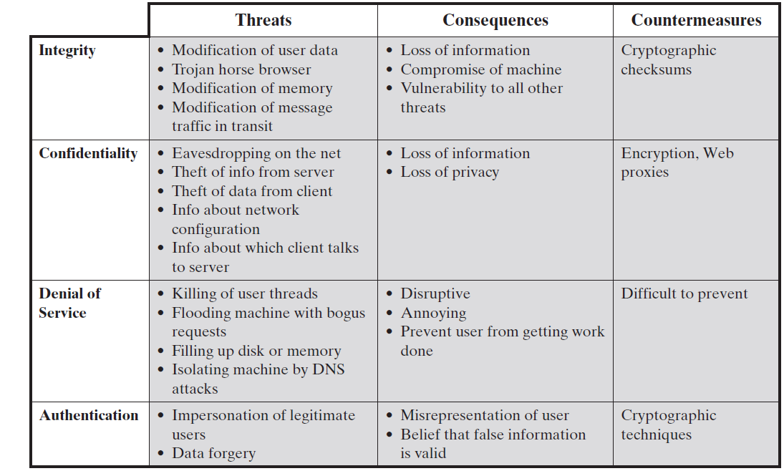
Web Security Threats

Slide 4
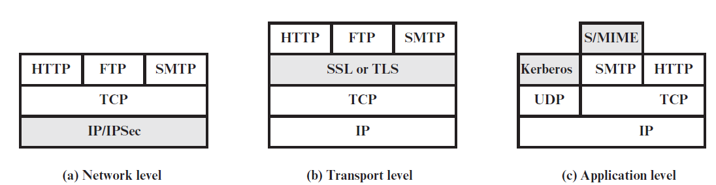
Web Traffic Security Approaches

Slide 5
IP Security (IPSec)
Collection of protocols designed by the Internet Engineering Task Force (IETF) to provide security for a packet at the network level.
Helps to create authenticated and confidential packets for the IP layer
Usefulness:
Enhance the security of those client/server programs, such as electronic mail, that use their own security protocols.
Enhance the security of those client/server programs, such as HTTP, that use the security services provided at the transport layer as well as that do not use the security services provided at the transport layer.
Provide security for node-to-node communication programs such as routing protocols.

Slide 6
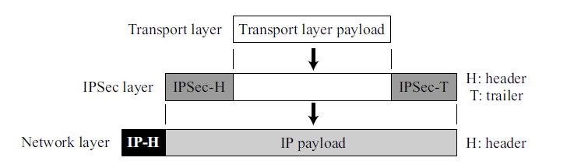
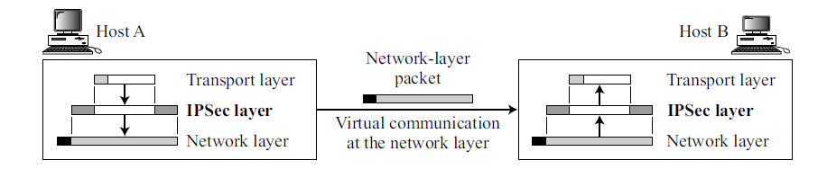
Modes of IPSec
Transport Mode
Here IPSec protects what is delivered from the transport layer to the network layer.
Protects the network layer payload, the payload to be encapsulated in the network layer
Does not protect the IP header; it only protects the information coming from the transport layer. In this mode, the IPSec header (and trailer) are added to the information coming from the transport layer. The IP header is added later.
Normally used for host-to-host (end-to-end) protection of data.
The sending host uses IPSec to authenticate and/or encrypt the payload delivered from the transport layer. The receiving host uses IPSec to check the authentication and/or decrypt the IP packet and deliver it to the transport layer.

Slide 7
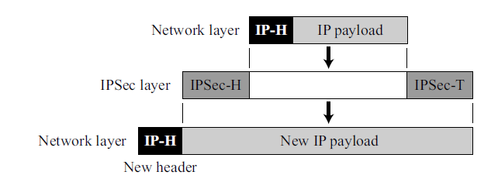
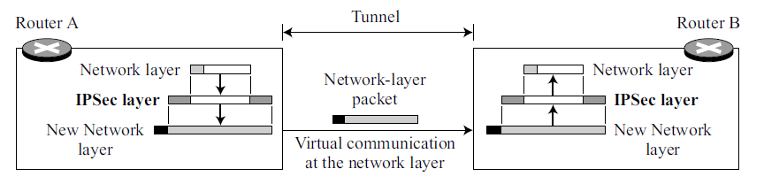
Modes of IPSec
Tunnel Mode
Here, IPSec protects the entire IP packet. It takes an IP packet, including the header, applies IPSec security methods to the entire packet, and then adds a new IP header
The new IP header has different information than the original IP header.
Normally used when either the sender or the receiver is not a host; example: between two routers, between a host and a router, or between a router and a host.
Entire packet is protected from intrusion between the sender and the receiver, as if the whole packet goes through an imaginary tunnel

Slide 8
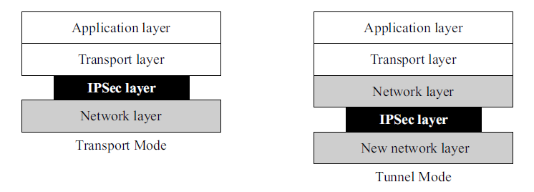
Modes of IPSec
Transport mode versus tunnel mode

Slide 9
Authentication Header (AH) Protocol
Designed to authenticate the source host and to ensure the integrity of the payload carried in the IP packet.
Uses a hash function and a symmetric key to create a message digest; the digest is inserted in the authentication header (AH). The AH is then placed in the appropriate location, based on the mode (transport or tunnel).
Steps:
An authentication header is added to the payload with the authentication data field set to 0.
Padding may be added to make the total length even for a particular hashing algorithm.
Hashing is based on the total packet. However, only those fields of the IP header that do not change during transmission are included in the calculation of the message digest (authentication data).
The authentication data are inserted in the authentication header.
The IP header is added after changing the value of the protocol field to 51 to show that the packet carries an authentication header.
The next header field inside authentication header holds the original value of the protocol field

Slide 10
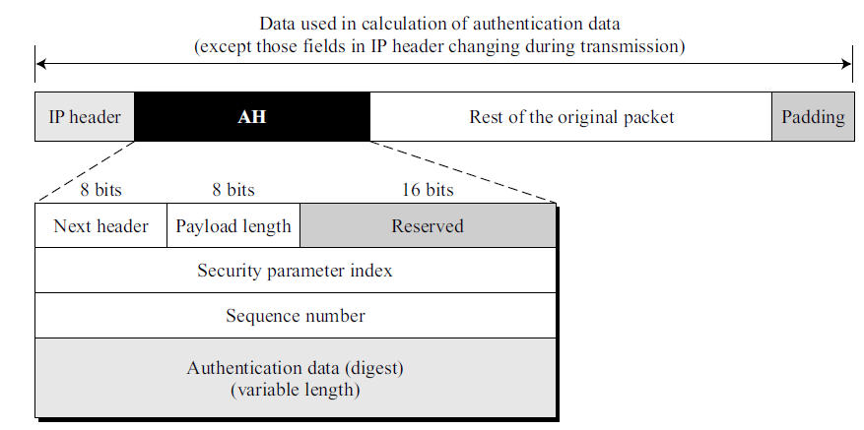
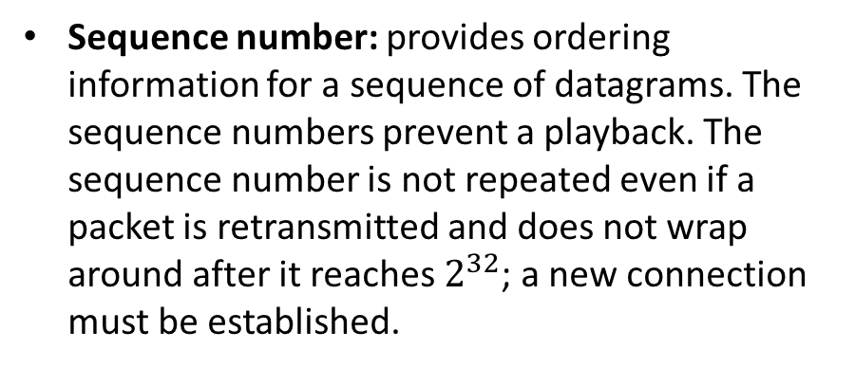
Authentication Header (AH) Protocol
Next header: defines the type of payload carried by the IP datagram (such as TCP, UDP, ICMP, or OSPF). The process copies the value of the protocol field in the IP datagram to this field.
Payload length: defines the length of the authentication header in 4-byte multiples excluding the first 8 bytes.
Security parameter index: plays the role of a virtual circuit identifier and is the same for all packets sent during a connection called a Security Association
Authentication data: result of applying a hash function to the entire IP datagram except for the fields that are changed during transit (e.g., time-to-live).
Sequence number: provides ordering information for a sequence of datagrams. The sequence numbers prevent a playback. The sequence number is not repeated even if a packet is retransmitted and does not wrap around after it reaches $2^{32}$; a new connection must be established.

Slide 11
Encapsulating Security Payload (ESP)
AH protocol does not provide privacy, only source authentication and data integrity.
Encapsulating Security Payload (ESP) provides source authentication, integrity, and privacy.
ESP adds a header and trailer. Authentication data are added at the end of the packet, which makes its calculation easier.
Steps:
An ESP trailer is added to the payload.
The payload and the trailer are encrypted.
The ESP header is added.
The ESP header, payload, and ESP trailer are used to create the authentication data.
The authentication data are added to the end of the ESP trailer.
The IP header is added after changing the protocol value to 50.

Slide 12
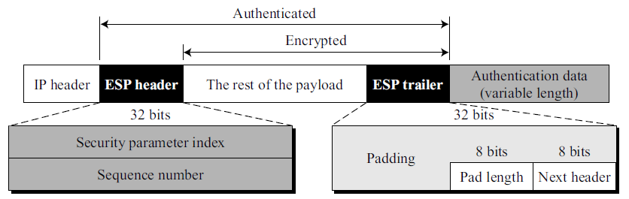
Encapsulating Security Payload (ESP)
Security parameter index and Sequence number: Similar to that defined for the AH protocol.
Padding: This variable-length field (0 to 255 bytes) of 0s serves as padding.
Pad length: The 8-bit pad-length field defines the number of padding bytes. The value is between 0 and 255; the maximum value is rare.
Next header: Similar to that defined in the AH protocol and serves the same purpose as the protocol field in the IP header before encapsulation.
Authentication data: Result of applying an authentication scheme to parts of the datagram.
The difference between authentication data in AH and ESP is: in AH, part of the IP header is included in the calculation of the authentication data; in ESP, it is not.
IPSec supports both IPv4 and IPv6. In IPv6, however, AH and ESP are part of the extension header

Slide 13
Services Provided by IPSec
Access Control: IPSec provides access control indirectly using a Security Association Database (SAD). If a packet arrives at a destination with no Security Association already established for this packet, the packet is discarded.
Message Integrity: Message integrity is preserved in both AH and ESP. A digest of data is created and sent by the sender to be checked by the receiver.
Entity Authentication: The Security Association and the keyed-hash digest of the data sent by the sender authenticate the sender of the data in both AH and ESP.
Confidentiality: The encryption of the message in ESP provides confidentiality. AH, however, does not provide confidentiality.
Replay Attack Protection: In both protocols, the replay attack is prevented by using sequence numbers and a sliding receiver window.

Slide 14
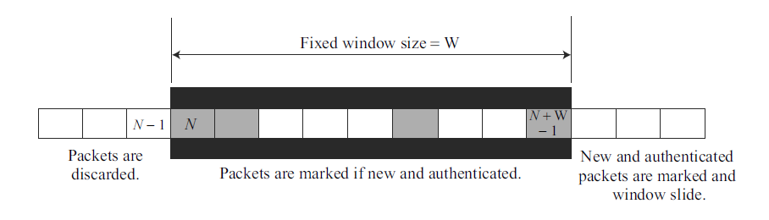
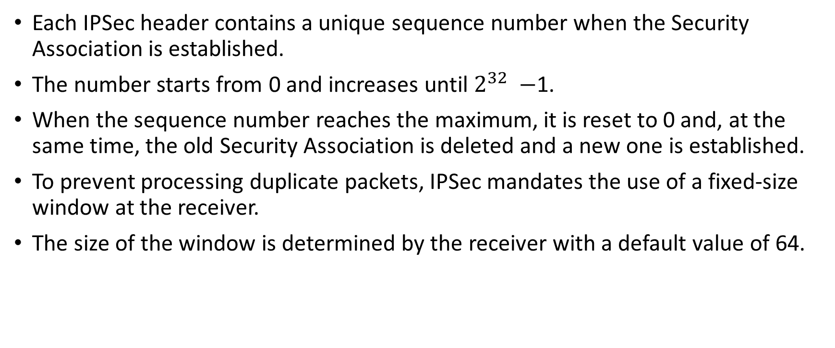
Replay Attack Protection
Each IPSec header contains a unique sequence number when the Security Association is established.
The number starts from 0 and increases until $2^{32} −$1.
When the sequence number reaches the maximum, it is reset to 0 and, at the same time, the old Security Association is deleted and a new one is established.
To prevent processing duplicate packets, IPSec mandates the use of a fixed-size window at the receiver.
The size of the window is determined by the receiver with a default value of 64.
The shaded packets signify received packets that have been checked and
authenticated

Slide 15
Replay Attack Protection
Case 1: The sequence number of the packet is less than N. This puts the packet to the left of the window. In this case, the packet is discarded. It is either a duplicate or its arrival time has expired.
Case 2: The sequence number of the packet is between N and (N + W − 1), inclusive. This puts the packet inside the window. In this case, if the packet is new (not marked) and it passes the authentication test, the sequence number is marked and the packet is accepted. Otherwise, it is discarded.
Case 3: The sequence number of the packet is greater than (N + W − 1). This puts the packet to the right of the window. In this case, if the packet is authenticated, the corresponding sequence number is marked and the window slides to the right to cover the newly marked sequence number. Otherwise, the packet is discarded.
If a packet arrives with a sequence number much larger than (N + W), then the sliding of the window may cause many unmarked numbers to fall to the left of the window. These packets, when they arrive, will never be accepted; their time has expired.

Slide 16
Transport Layer Security (TLS)
An Internet standard that evolved from a commercial protocol known as Secure Sockets Layer (SSL).
Current version is Version 1.3
Although SSL implementations are still around, it has been deprecated by IETF and is disabled by most corporations offering TLS software.
TLS is a general purpose service implemented as two layers of protocols that rely on TCP.
There are two implementation choices.
For full generality, TLS could be provided as part of the underlying protocol suite and therefore be transparent to applications.
Alternatively, TLS can be embedded in specific packages. For example, most browsers come equipped with TLS, and most Web servers have implemented the protocol.

Slide 17
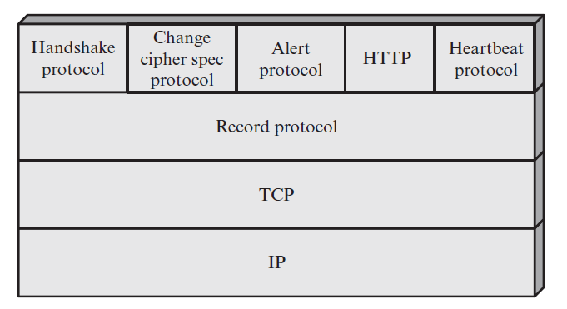
Transport Layer Security (TLS)
Designed to make use of TCP to provide a reliable end-to-end secure service
The TLS Record Protocol provides basic security services to various higher layer protocols. In particular, the Hypertext Transfer Protocol (HTTP), which provides the transfer service for Web client/server interaction, can operate on top of TLS.
Three higher-layer protocols are defined as part of TLS and used in the management of TLS exchanges
Handshake Protocol
Change Cipher Spec Protocol
Alert Protocol.
Heartbeat Protocol is defined in a separate RFC
TLS Protocol Stack

Slide 18
Transport Layer Security (TLS)
Connection: A connection is a transport (in the OSI layering model definition) that provides a suitable type of service.
For TLS, such connections are peer-to-peer relationships.
The connections are transient.
Every connection is associated with one session.
Session: A TLS session is an association between a client and a server.
Sessions are created by the Handshake Protocol.
Sessions define a set of cryptographic security parameters, which can be shared among multiple connections.
Used to avoid the expensive negotiation of new security parameters for each connection.

Slide 19
Transport Layer Security (TLS)
A session state is defined by the following parameters:
Session identifier: An arbitrary byte sequence chosen by the server to identify an active or resumable session state.
Peer certificate: An X509.v3 certificate of the peer. This element of the state may be null.
Compression method: The algorithm used to compress data prior to encryption.
Cipher spec: Specifies the bulk data encryption algorithm (such as null, AES, etc.) and a hash algorithm (such as MD5 or SHA-1) used for MAC calculation. It also defines cryptographic attributes such as the hash_size.
Master secret: 48-byte secret shared between the client and server.
Is resumable: A flag indicating whether the session can be used to initiate new connections.

Slide 20
Transport Layer Security (TLS)
A connection state is defined by the following parameters:
Server and client random: Byte sequences that are chosen by the server and client for each connection.
Server write MAC secret: The secret key used in MAC operations on data sent by the server.
Client write MAC secret: The symmetric key used in MAC operations on data sent by the client.
Server write key: The symmetric encryption key for data encrypted by the server and decrypted by the client.
Client write key: The symmetric encryption key for data encrypted by the client and decrypted by the server.

Slide 21
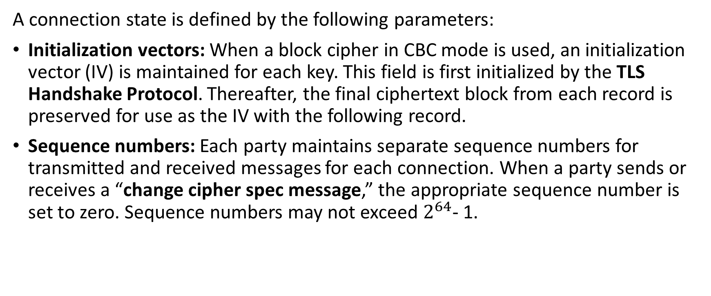
Transport Layer Security (TLS)
A connection state is defined by the following parameters:
Initialization vectors: When a block cipher in CBC mode is used, an initialization vector (IV) is maintained for each key. This field is first initialized by the TLS Handshake Protocol. Thereafter, the final ciphertext block from each record is preserved for use as the IV with the following record.
Sequence numbers: Each party maintains separate sequence numbers for transmitted and received messages for each connection. When a party sends or receives a “change cipher spec message,” the appropriate sequence number is set to zero. Sequence numbers may not exceed $2^{64}$- 1.
Cipher block chaining (CBC) is a mode of operation for a block cipher -- one in which a sequence of bits are encrypted as a single unit, or block, with a cipher key applied to the entire block. It uses an initialization vector (IV) of a certain length.

Slide 22
Transport Layer Security (TLS)
In theory, there may also be multiple simultaneous sessions between parties, but this feature is not used in practice.
Once a session is established, there is a current operating state for both read and write (i.e., receive and send).
In addition, during the Handshake Protocol, pending read and write states are created.
Upon successful conclusion of the Handshake Protocol, the pending states become the current states.

Slide 23
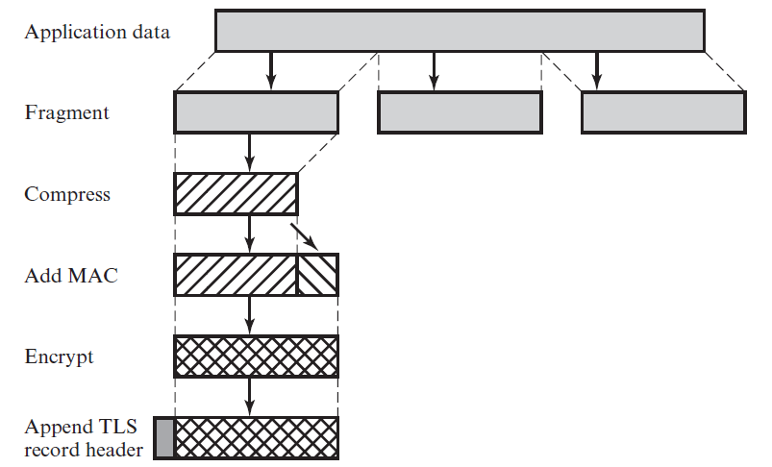
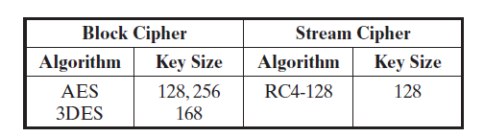
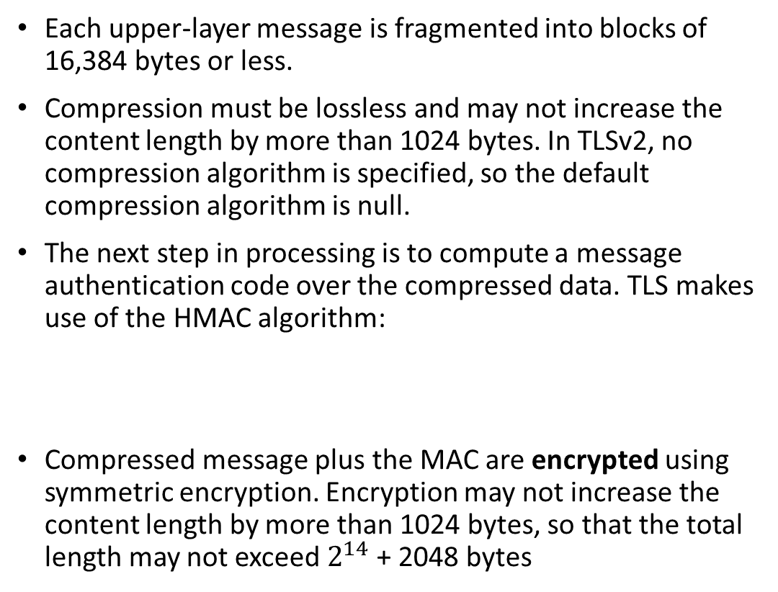
TLS Record Protocol
TLS Record Protocol Operation
Each upper-layer message is fragmented into blocks of 16,384 bytes or less.
Compression must be lossless and may not increase the content length by more than 1024 bytes. In TLSv2, no compression algorithm is specified, so the default compression algorithm is null.
The next step in processing is to compute a message authentication code over the compressed data. TLS makes use of the HMAC algorithm:
Compressed message plus the MAC are encrypted using symmetric encryption. Encryption may not increase the content length by more than 1024 bytes, so that the total length may not exceed $2^{14}$ + 2048 bytes

Slide 24
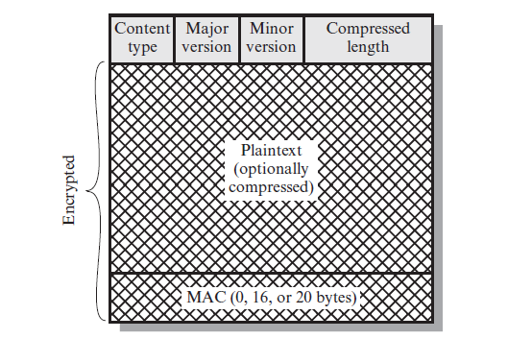
TLS Record Protocol
The final step of TLS Record Protocol processing is to prepend a header consisting of the following fields:
Content Type (8 bits): The higher-layer protocol used to process the enclosed fragment.
Major Version (8 bits): Indicates major version of TLS in use. For TLSv2, the value is 3.
Minor Version (8 bits): Indicates minor version in use. For TLSv2, the value is 1.
Compressed Length (16 bits): The length in bytes of the plaintext fragment (or compressed fragment if compression is used).
TLS Record Format

Slide 25
TLS Record Protocol
TLS Record Protocol Operation
Provides two services for TLS connections:
Confidentiality: The Handshake Protocol defines a shared secret key that is used for conventional encryption of TLS payloads.
Message Integrity: The Handshake Protocol also defines a shared secret key that is used to form a message authentication code (MAC).
Takes an application message to be transmitted, fragments the data into manageable blocks, optionally compresses the data, applies a MAC, encrypts, adds a header, and transmits the resulting unit in a TCP segment.
Received data are decrypted, verified, decompressed, and reassembled before being delivered to higher-level users.

